Slide 1

Weather Forecast App in Python
Join us as we explore the creation of a simple but effective weather forecast application using the power of Python.
mi
by mohammad ibrahim

Slide 2
Core Libraries & Setup
requests
json
tkinter (optional)
For fetching weather data from APIs. Install with `pip install requests` and import with `import requests`.
For parsing JSON responses from the API. Built-in, no installation needed. Use `import json`.
For creating a graphical user interface (GUI). Install with `pip install tkinter`.

Slide 3

Data Source: Weather APIs
OpenWeatherMap
AccuWeather
WeatherAPI.com
Provides free and paid tiers with various endpoints for weather data.
Offers detailed weather forecasts and historical data.
Provides real-time weather conditions and forecasts with global coverage.

Slide 4
Key Functions: Fetching and Parsing Data
get_weather_data(city, api_key)
parse_weather_data(json_data)
Fetches weather data from the API based on city and API key. Returns a dictionary containing JSON data.
Extracts relevant weather information from the JSON data. Returns a dictionary with formatted weather information.

Slide 5

Code Example: Displaying Current Weather
def data_get(): city = city_name.get() if city: try: url = f"https://api.openweathermap.org/data/2.5/weather?q={city}&appid=7d890a62d9d759226b0ec88c803d273d" response = requests.get(url) data = response.json() if data["cod"] == 200: w_label1.config(text=data["weather"][0]["main"]) wb_label1.config(text=data["weather"][0]["description"]) temp_label1.config(text=str(int(data["main"]["temp"] - 273.15))) per_label1.config(text=data["main"]["pressure"]) else: w_label1.config(text="City not found") wb_label1.config(text="") temp_label1.config(text="") per_label1.config(text="") except requests.exceptions.RequestException as e: print(f"Error fetching data: {e}") w_label1.config(text="Error") wb_label1.config(text="") temp_label1.config(text="") per_label1.config(text="") else: w_label1.config(text="Please select a city") wb_label1.config(text="") temp_label1.config(text="") per_label1.config(text="")

Slide 6
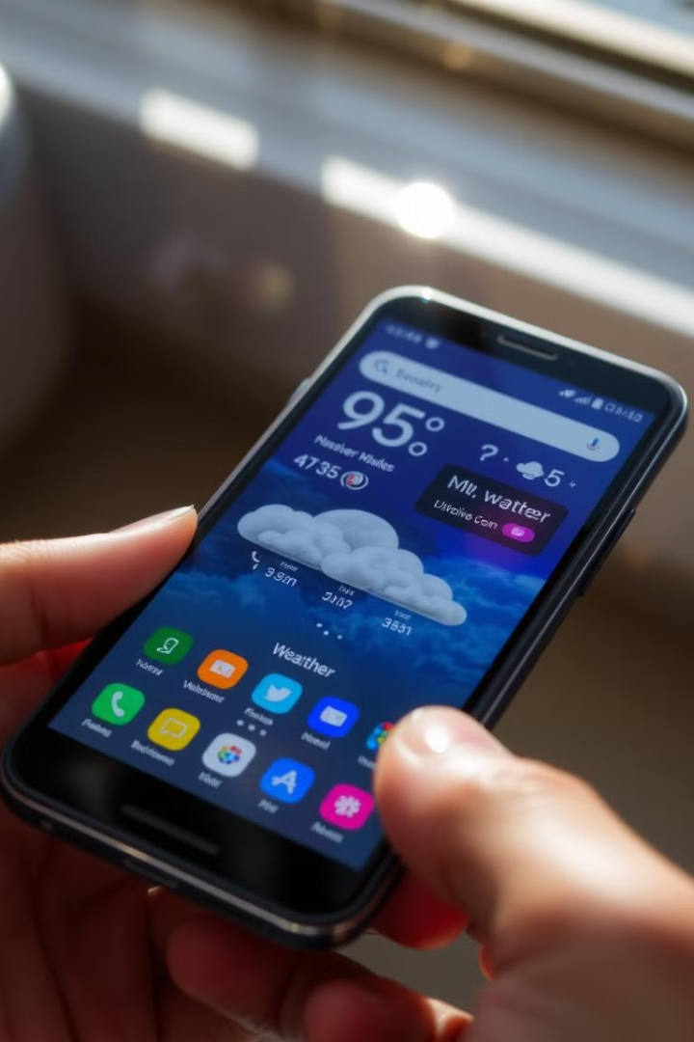



Enhancing User Experience: Building a Simple UI
Text input for city name.
Button to fetch weather data.
Labels to display temperature, condition, humidity.

Slide 7
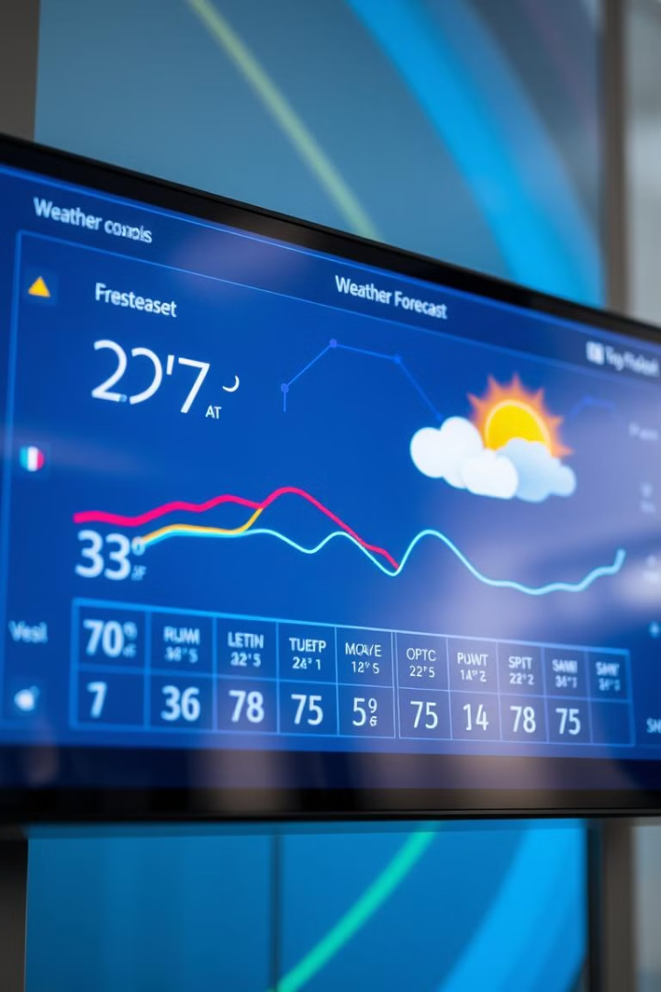
Future Improvements and Features
1
Multi-day Forecast
Display weather data for multiple days ahead.
2
Location Detection
Automatically determine the user's location.
3
Weather Alerts
Notify users about severe weather conditions.
4
UI Enhancements
Add icons, charts, and more visual elements to improve the user experience.

Slide 8

Conclusion and Next Steps
We've explored a simple weather forecast app, demonstrating the power of Python and weather APIs. Now, you can build upon this foundation and create your own personalized weather application.

